Slide 1
Research Computing Committee –April 2021
29 April 2021

Slide 2
Research Computing Committee
2
Agenda
New HPC Status
User account process and resource allocation on New HPC
Migration of Masdar resources and SAN HPC
Research Computing strategy
AOB
Date of next meeting

Slide 3
Research Computing Committee Charter
3
New HPC Status
New HPC - Almesbar
New hardware purchased and delivered at end of December 2020
There was some technical issues with the networking that caused some delay in the installation. These are all resolved now.
Hardware is installed and configured.
Currently pending integration with KU authentication systems. The aim is to have single sign on, i.e. unified login details for KU email, laptops and HPC etc…
RC team in in process of installing applications and improving on how applications are loaded/unloaded using module environment.
Expect to have test users on system by mid-May

Slide 4
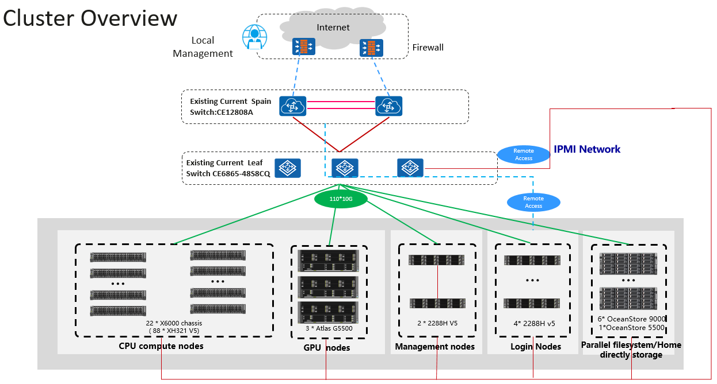
Research Computing Committee Charter
4
Cluster overview

Slide 5
Research Computing Committee Charter
5
Almesbar HPC Cluster
Number of nodes |  | Cores per node |  | Network interconnection |  | Total CPU cores | Theoretical peak of performance
88 CPU nodes | 2x Intel Xeon Gold 6230R 26-Core 2.1GHz (Cascade lake) (Q1‘20) | 52 |  | Infiniband HDR and Infiniband EDR |  | 4,732 | 401.9 TFOPS
 |  |  |  |  |  | Total GPU cores
 |  | Memory per node |  | Storage
 |  |  |  |  |  | 61,440
3 GPU nodes | 2x Intel Xeon Gold 6230R 26-Core 2.1GHz(Cascade lake) (Q1’20) | CPU nodes | 384 GB | 300 TB home | NFSv4 |  | Estimated peak of performance
 |  |  |  |  |  |  | 321.52 TFOPS
 |  |  |  |  |  | Total memory
 | 4x NVidia V100 | GPU nodes | 640 GB + 128 GB (GPU) | 947 TB scratch | Parallel file system (Lustre)
 |  |  |  |  |  | 35.25 TB

Slide 6
Research Computing Current resources
6
Comparison of performance
Masdar Campus Cluster |  | Components | Number of Nodes | Theoretical Peak Performance (Rpeak) Teraflops
 | CPU Compute Nodes | 2x Intel Xeon E5-2690 v3 12-Core 2.6GHz (Haswell - 2014) | 64 | 62.4
 |  | 2x Intel Xeon E5-2697 v2 12-Core 2.7GHz (Ivy Bridge - 2013) | 16 | 8.1
 | GPU Accelerated Nodes | 2x Intel Xeon E5-2695 v2 12Core 2.4GHz (Ivy Bridge) and dual GPU Nvidia K20M | 4 | 11.2
SAN Campus Cluster | CPU Compute Nodes | 2x Intel Xeon E5-2690 v3 12-Core 2.6GHz (Haswell - 2014) | 41 | 24.6
 |  | 2x Intel Xeon E5-2697 v2 12-Core 2.7GHz (Ivy Bridge - 2013) | 23 | 4.9
 |  | 2x Intel Xeon E5530 4-Core 2.4GHz (Nehalem - 2009) | 9 | 0.7
 | GPU Accelerated Nodes | 2x Intel Xeon E5-2630 v3 8-Core 2.4GHz (Haswell) and 4x GPU Nvidia K80 | 6 | 48.5
 | Total for existing clusters |  | 163 | 160.3
Almesbar Cluster | CPU Compute Nodes | 2x Intel Xeon Gold 6230R 26-Core 2.1GHz (Cascade lake) (Q1‘20) | 88 | 401.9
 | GPU Accelerated Nodes | 2x Intel Xeon Gold 6230R 26-Core 2.1GHz(Cascade lake) (Q1’20) and four GPU Nvidia Tesla V100 cards | 3 | 321.52
 | Total for new cluster |  | 91 | 401.9

Slide 7
Research Computing Committee
7
Agenda
New HPC Status
User account process and resource allocation on New HPC
Migration of Masdar resources and SAN HPC
Research Computing strategy
AOB
Date of next meeting

Slide 8
Research Computing Committee Charter
8
User Accounts process and resource allocation
Resources on the HPC will be allocated to Research Projects.
This will provide a means to quantify the research that is being supported by the HPC, and can be used to justify further investments.
There will be provision made for unfunded research, but likely at lower priority in the queues
User account process will consist of two distinct steps.
Project Creation: PI’s will need to apply to enable/create their project or projects on the HPC. This will be done using an online form, with a dropdown list of current active projects as defined by ADERP and Research Services. PI’s can have multiple projects
User creation: Users will then apply for account on HPC, that is linked to a specific project. Users can belong to multiple projects
I will be sending you the detailed process, for your endorsement.

Slide 9
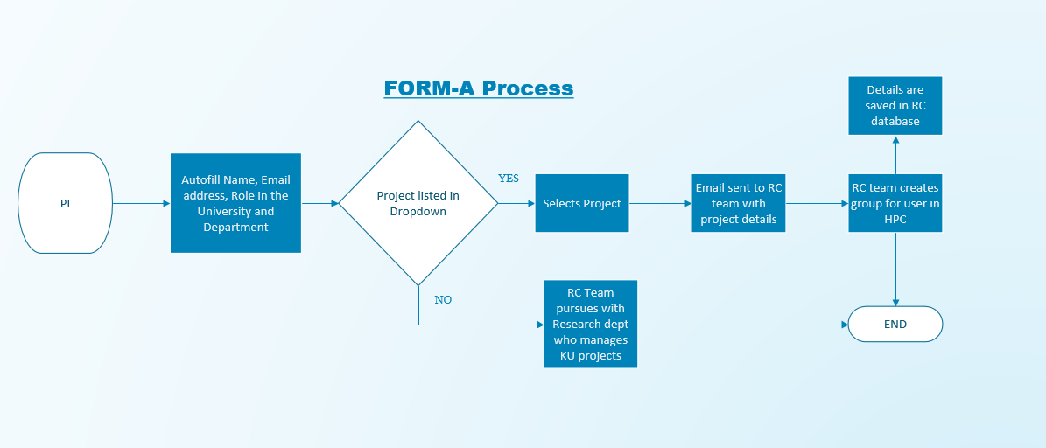
Research Computing Committee Charter
9
User Accounts process
Creation of Projects on HPC flowchart - Form-A

Slide 10
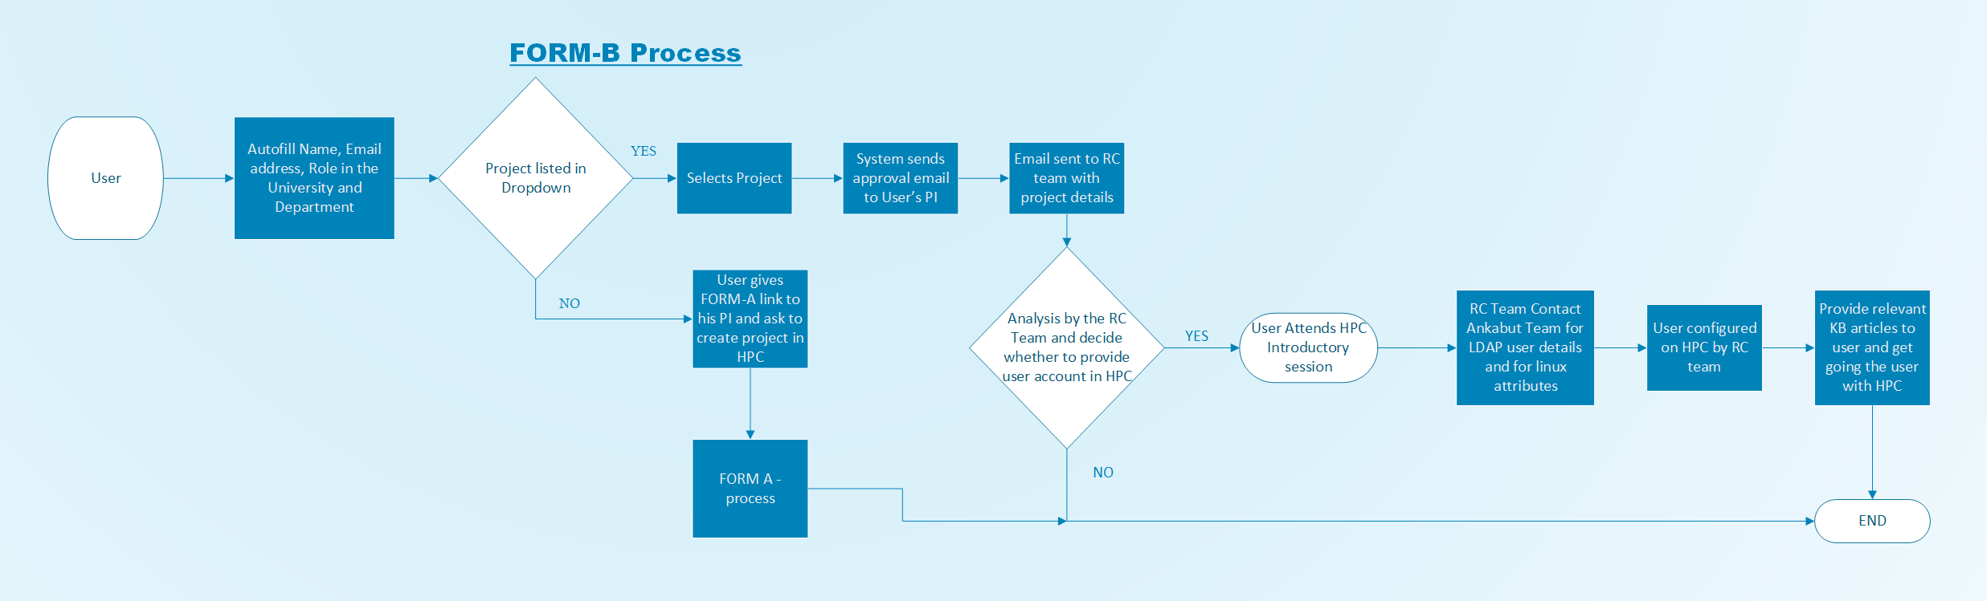
Research Computing Committee Charter
10
User Accounts process
Creation of Users on HPC flowchart – Form-B

Slide 11
Research Computing Committee
11
Agenda
New HPC Status
User account process and resource allocation on New HPC
Migration of Masdar resources and SAN HPC
Research Computing strategy
AOB
Date of next meeting

Slide 12
Research Computing Committee Charter
12
Masdar and SAN HPC resources
High Performance Computing clusters
Virtual Machines
We are currently managing around 50 virtual machines dedicated to different purposes: Data bases, web servers, research machines, with ~228 TB of storage.
SAN HPC was scheduled to be decommissioned at end of Jan 2021. Currently pending with ADNOC.
Masdar Resources to be decommissioned this summer, currently finalizing timeline and migration plan
 | Compute nodes | GPU nodes | Memory | Storage
MI HPC cluster | 80 | 4 | 256 GB | ~45 TB
SAN HPC cluster | 76 | 6 | From 16 GB to 128 GB | ~100 TB

Slide 13
Research Computing Committee
13
Agenda
New HPC Status
User account process and resource allocation on New HPC
Migration of Masdar resources and SAN HPC
Research Computing strategy
AOB
Date of next meeting

Slide 14
Research Computing Strategy
14
Research Computing strategy
Goals
Different levels of computational requirements
Private Cloud/VM strategy
HPC Strategy
Data Storage
Software
Support

Slide 15
Research Computing Strategy
15
Goals
Sustainability
Computer based modelling and simulation firmly established as integral parts of scientific research
Provision of resources needs to be consistent and sustainable.
This would entail periodic investment by KU. Appropriate life-cycle management needs to be implemented.
Notes:
Sustainability: Provision of research computing hardware resources needs to be consistent and sustainable. This would entail periodic investment by KU. Alongside this, appropriate life cycle management needs to be implemented;useful lifetime of equipment needs to be defined, the equipment then repurposed and retired as appropriate.

Slide 16
Research Computing Strategy
16
Goals
Multiple Levels of Computation
One size does not fit all
Requirements range from powerful workstations, to cloud services, university level HPC as well as large scale/national level HPC
Need to develop efficient and simple mechanisms for capturing and satisfying these requirements
Medium level Computation
Some computational tasks cannot be carried out on standard laptops/desktops but are not suited to High Performance Computing (HPC) clusters.
Centralize where possible, through providing access to private cloud and virtual machines/labs
Use public cloud for test beds and services not available locally
This will simplify management, security and data protection, provisioning, access to software and remove system administration burden from researchers
Notes:
Multiple levels of computation: It is important to acknowledge that one size does not fit all, and that there multiple levels of computational requirements across research. These would range from workstations, to cloud services, university level HPC as well as national level supercomputer access. Processes and mechanisms for capturing and satisfying all of these requirements need to be developed. It is crucial that these mechanisms and processes be as simple and efficient as possible and easily accessible to KU researchers.

Slide 17
Research Computing Strategy
17
Private Cloud/VM strategy 2021 - 2025
 | 2021 | 2022 | 2023 | 2024 | 2025
Private cloud provision | Hosted at Masdar (not cloud): 474 vCPUs 228 TB of storage | 474 vCPUs 228 TB of storage | 567 vCPUs 300 TB of storage | 680 vCPUs 400 TB of storage | 816 vCPUs 600 TB of storage
Action | Liaise with Ankabut to migrate above workload and storage. Purchase private cloud infrastructure to host above workload and allow for expansion and growth. Important to note, budgeted amount based on assumption that KU can leverage existing Ankabut investment. As this is no longer the case budget estimates can be inaccurate at moment, and will be corrected in time. | Expand private cloud vCPU provision by 20% and data storage by 30 % to allow for growing demand. Develop processes and criteria for resource allocation Liaise with colleagues in Research Department and Ankabut to lobby KU Finance to create mechanism to use funds from research projects to purchase IT services from Ankabut, or to expand existing services. Form partnerships with Public Cloud providers to accommodate non-standard computational requirements, e.g. ASIC, FPGAs .., and test beds, and to complement KU offerings. Use OPEX to purchase public cloud services | Expand private cloud provision by 20% and data storage by 30% allow for growing demand. Evaluate any services utilized on public cloud, to see if services should be provided at KU. Continue to work with Public Cloud providers to accommodate non-standard requirements. | Expand private cloud provision by 20% and data storage by 30%. Evaluate any services utilized on public cloud, to see if services should be provided at KU. Continue to work with Public Cloud providers Extend support for private cloud hardware to 2025 | Evaluate available technology. Gather KU requirements. Decide course of action; carry on expanding services or procure new services.
CAPEX | 2.9M AED (estimated) | 700K AED (estimated) | 700K AED (estimated) | 700K (estimated) | TBD
OPEX |  | 200K AED (estimated) | 200K AED (estimated) | 825K AED (estimated) | 200K AED

Slide 18
Research Computing Strategy
18
Goals
High Performance Computing
Replace current ageing cluster with an HPC cluster of adequate size to enable researchers to produce results in a timely manner as well as explore new research topics.
Allow researchers to develop skills and tools required to make use of larger scale HPC.
HPC should be accessible to all who require it, permit access to funded and unfunded research and researchers should be actively encouraged to use the service.
Establish mechanism to expand resources using external grant funding for projects that require a higher level of provision. These can be dedicated to the project or shared with a common pool.
Assist researchers with accessing larger HPC resources, where appropriate. These could include large scale/national level HPC, such as at KAUST, or from commercial cloud providers.

Slide 19
Research Computing Strategy
19
HPC Strategy 2021 - 2025
 | 2021 | 2022 | 2023 | 2024 | 2025
HPC provision | 88 CPU nodes ( 4,576 CPU cores) 3 GPU nodes (12 GPU Nvidia V100 cards, 156 CPU cores) 300 TB /home storage 974 TB /scratch storage | 118 CPU nodes (6,136 CPU cores) 5 GPU nodes (20 GPU Nvidia V100 cards, 260 CPU cores) 500TB /home storage 974 TB /scratch storage | 140 CPU nodes (7,280 CPU cores) 5 GPU nodes 700TB /home storage 974 TB /scratch storage | 140 CPU nodes 5 GPU nodes 700TB /home storage 974 TB /scratch storage | 140 CPU nodes 5 GPU nodes 700TB /home storage 974 TB /scratch storage
Action | Expand HPC by: 30 CPU nodes (1,560 CPU cores) 2 GPU nodes (8 GPU Nvidia V100 cards, 104 CPU cores) 200 TB /home storge | Expand HPC by: 22 CPU nodes (1,040 CPU Cores) 200 TB /home storage Operate HPC, gather evidence and data on usage and demands | Operate HPC, gather evidence and data on usage and demands | Form task force to evaluate available technology. Gather KU requirements. Decide course of action; replace HPC cluster or upgrade if possible. Extend support for HPC hardware to 2025 | Upgrade or replace HPC based on requirements and demands. May require changes to Datacenter as regards cooling and power provision to racks. This will incur a cost
CAPEX | 3M AED (estimated) | 2M AED (estimated) |  |  | TBD
OPEX |  |  |  | 1.2M AED (estimated) | 1.2M AED (estimated)

Slide 20
Research Computing Strategy
20
Goals
Data Storage
Underlying all computational resources, should be robust and reliable storage services, which conform to some basic principles:
Data Management: Provide tools, processes to allow researchers to comply to KU data management policies
Tiered Storage: Services should span multiple performance and functional requirements, ranging from HPC storage to long term backup
Accessibility: Accessible from a variety of computing platforms, without jeopardizing security
Funding & allocation: Should be funded and run centrally. Processes for resource allocation will need to be established
Expandability: Establish mechanism to expand storage using external grant funding for projects that require a higher level of provision

Slide 21
Research Computing Strategy
21
Data Storage Gaps and challenges
Data Management policies: There is a need for clear and comprehensive data management polices for KU.
Large scale research data storage: There is a need for processes, tools and infrastructure for large scale storage of research data, in compliance with data management policies of KU.
General purpose storage: A need for general purpose storage accessible from faculty/researcher laptop and workstations.
Funding from research projects: There is a need for a mechanism to use project funds to purchase storage, via CAPEX, but also via OPEX
Purchasing IT services: Current rules mean that KU is unable to transfer funds to Ankabut or pay them for IT services. This means that RC and KU cannot leverage existing IT infrastructure, and this means that KU will continually need to invest large amounts of CAPEX to fund services.

Slide 22
Research Computing Strategy
22
Data Storage Strategy 2021 - 2025
 | 2021 | 2022 | 2023 | 2024 | 2025
Storage provision | 300 TB HPC /home storage 974 TB HPC /scratch storage 228 TB of private cloud storage | 500TB HPC /home storage 974 TB HPC /scratch storage 228 TB of private cloud storage | 700TB HPC /home storage 974 TB HPC /scratch storage 300 TB of private cloud storage | 700TB HPC /home storage 974 TB HPC /scratch storage 400 TB of private cloud storage | 700TB HPC /home storage 974 TB HPC /scratch storage 600 TB of private cloud storage
Action | Migration of data at Masdar and SAN campuses to KU Campus resources | Form working group to develop comprehensive Data Management Policies for KU Liaise with colleagues in Research Department and Ankabut to lobby KU Finance to create mechanism to use funds from research projects to purchase IT services from Ankabut, or to expand existing services. | With Data Management Policies in place, gather requirements for new storage services. Design new storage services and request budget. | Liaise with Ankabut to procure and install new storage services. | Evaluate service and gather data.
CAPEX |  |  |  | TBD
OPEX |  |  |  | TBD

Slide 23
Research Computing Strategy
23
Goals
Software
Though progress has been made to streamline the funding, purchasing and consolidation of software licenses, this can be improved.
Only a small number of software applications widely used by researchers currently funded via Research Computing. Typically site licensed software, and/or used across multiple departments
Need to establish a process to determine which software should be funded centrally.
The aim is to simplify management, and streamline purchasing. This may also enable monitoring the utilization of licenses, to help with making decisions about the level of license provision.

Slide 24
Research Computing Strategy
24
Goals
Support
Work in conjunction with researchers to design and implement bespoke computing resources to support research projects.
Support researchers by understanding their research computational needs and recommend suitable applications and other research computing resources available at the University.
Develop and maintain documentation and guidelines to assist users to make use of computational resources
Provide scientific computing support.
Evaluating, optimizing and deploying new software on the HPC clusters
Application profiling and performance evaluation
Continue to develop and deliver specialized training courses.

Slide 25
Research Computing Committee
25
Agenda
New HPC Status
User account process and resource allocation on New HPC
Migration of Masdar resources and SAN HPC
Research Computing strategy
AOB
Date of next meeting

